Slide 1


HEP NTUA Weekly Report 18/12/2020
George Bakas

Slide 2
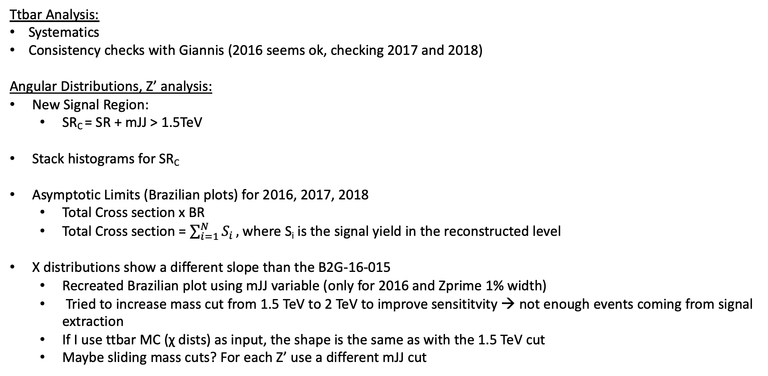
Summary
Ttbar Analysis:
Systematics
Consistency checks with Giannis (2016 seems ok, checking 2017 and 2018)
Angular Distributions, Z’ analysis:
New Signal Region:
SR_{C} = SR + mJJ > 1.5TeV
Stack histograms for SR_{C}
Asymptotic Limits (Brazilian plots) for 2016, 2017, 2018
Total Cross section x BR
Total Cross section = $\sum_{i=1}^{N}{S_{i}},$where S_{i} is the signal yield in the reconstructed level
Χ distributions show a different slope than the B2G-16-015
Recreated Brazilian plot using mJJ variable (only for 2016 and Zprime 1% width)
Tried to increase mass cut from 1.5 TeV to 2 TeV to improve sensititvity → not enough events coming from signal extraction
If I use ttbar MC (χ dists) as input, the shape is the same as with the 1.5 TeV cut
Maybe sliding mass cuts? For each Z’ use a different mJJ cut

Slide 3
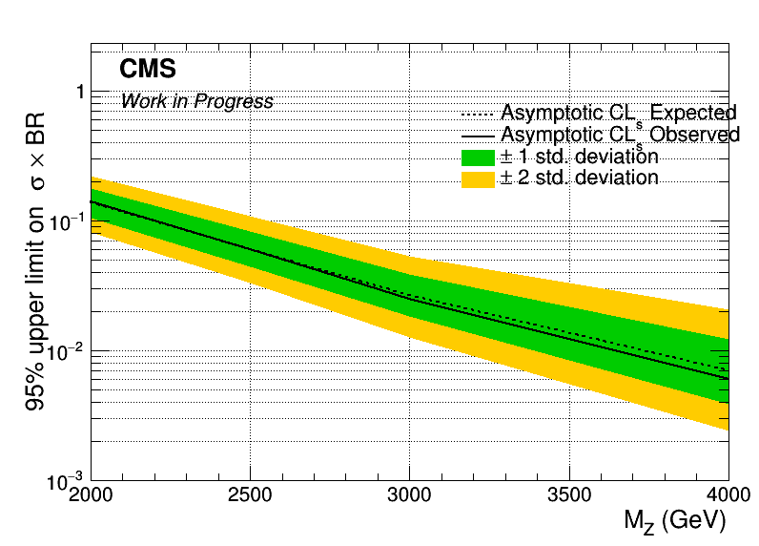
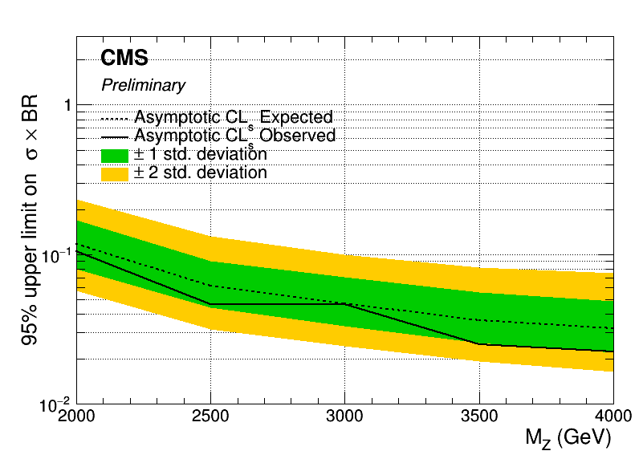
Asymptotic Limits width 1%
2016
B2G-16-015

Slide 4
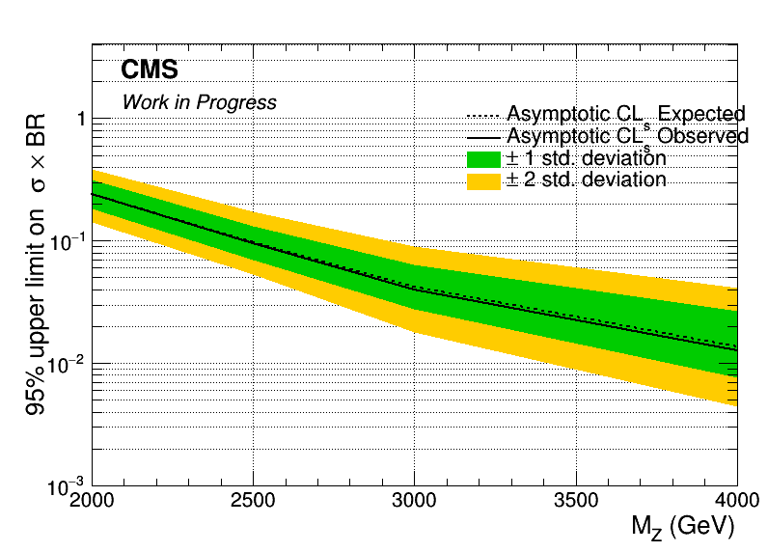
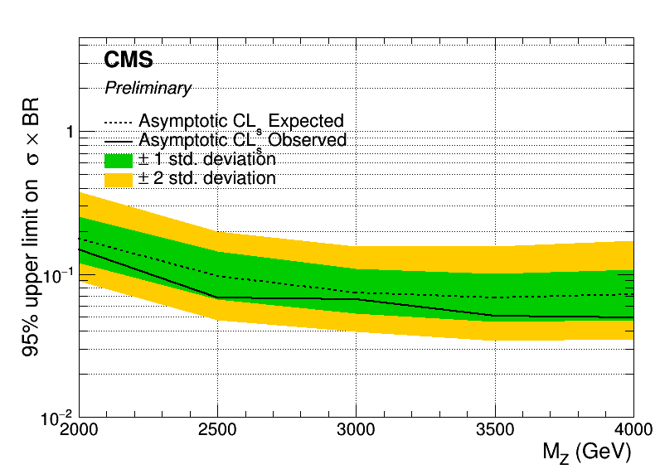
Asymptotic Limits width 10%
2016
B2G-16-015

Slide 5
BACKUP

Slide 6
Signal Selection
Control Region Selection
Variables | Selected Cut
pT (both leading jets) | > 400 GeV
Njets | > 1
N leptons | = 0
|eta| (both leading jets) | < 2.4
mJJ | > 1000 GeV
jetMassSoftDrop (only for fit) | (50,300) GeV
Top Tagger | > 0.2, 0, 0.1
B tagging (2 btagged jets) | > Medium WP
Signal Trigger
Variables | Selected Cut
pT (both leading jets) | > 400 GeV
Njets | > 1
N leptons | = 0
|eta| (both leading jets) | < 2.4
mJJ | > 1000 GeV
jetMassSoftDrop (only for fit) | (50,300) GeV
Top Tagger | > 0.2, 0, 0.1
B tagging (0 btagged jets) | < Medium WP
Control Trigger

Slide 7
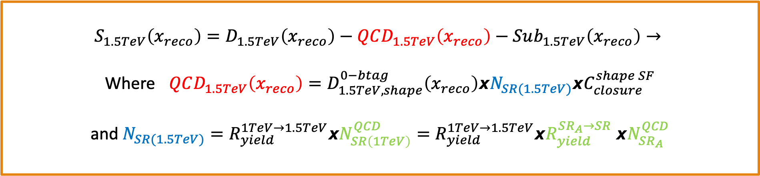
Signal Extraction
$$S_{1.5TeV}\left(x_{reco}\right)=D_{1.5TeV}\left(x_{reco}\right)−QCD_{1.5TeV}\left(x_{reco}\right)−Sub_{1.5TeV}\left(x_{reco}\right)→$$
Where $QCD_{1.5TeV}\left(x_{reco}\right)=D_{1.5TeV, shape}^{0−btag}\left(x_{reco}\right)xN_{SR(1.5TeV)}{xC}_{closure}^{shape SF}$
and $N_{SR(1.5TeV)}=R_{yield}^{1TeV→1.5TeV}xN_{SR\left(1TeV\right)}^{QCD}=R_{yield}^{1TeV→1.5TeV}xR_{yield}^{SR_{A}→SR} {xN}_{SR_{A}}^{QCD}$
The variable of interest here: x_{reco} → χ
1.5 TeV refers to the mJJ cut
We deploy a fit in the Signal Region (2btag) to extract the $N_{QCD}^{fit}$ in SRA (mJJ > 1TeV)
$$D{\left(m^{t}\right)}^{(i)}=N_{tt}^{(i)}T^{(i)}\left(m^{t},k_{MassScale}, k_{MassResolution}\right)+N_{bkg}^{(i)}B\left(m^{t} \right)\left(1+k_{1}x\right)+N_{sub}^{(i)}O^{(i)}\left(m^{t}\right)$$

Slide 8
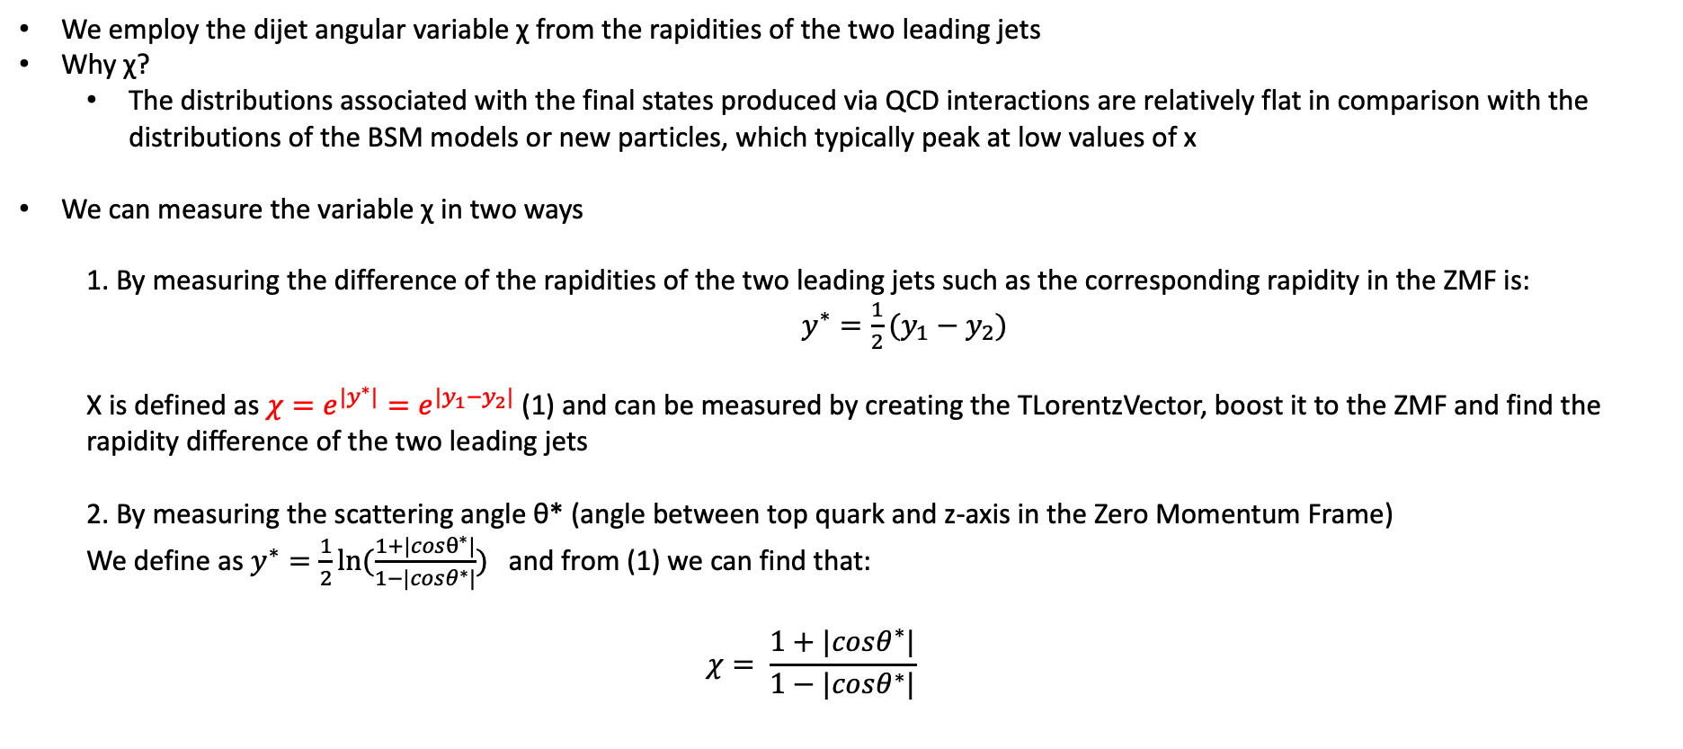
Top Angular Distributions
We employ the dijet angular variable χ from the rapidities of the two leading jets
Why χ?
The distributions associated with the final states produced via QCD interactions are relatively flat in comparison with the distributions of the BSM models or new particles, which typically peak at low values of x
We can measure the variable χ in two ways
1. By measuring the difference of the rapidities of the two leading jets such as the corresponding rapidity in the ZMF is: $y^{∗}=\frac{1}{2}(y_{1}−y_{2})$
Χ is defined as $χ=e^{{|y}^{∗}|}=e^{|y_{1}−y_{2}|}$ (1) and can be measured by creating the TLorentzVector, boost it to the ZMF and find the rapidity difference of the two leading jets
2. By measuring the scattering angle θ* (angle between top quark and z-axis in the Zero Momentum Frame)
We define as $y^{∗}=\frac{1}{2}ln⁡(\frac{1+|cosθ^{∗}|}{1−|cosθ^{∗}|})$ and from (1) we can find that:
$$χ= \frac{1+|cosθ^{∗}|}{1−|cosθ^{∗}|}$$

Slide 9
Stack Distributions vs B2G-16-015 Mz=2TeV, w 1%
2016
2018
2017

Slide 10
Stack Distributions vs B2G-16-015 Mz=2TeV, w 10%
2016
2018
2017

Slide 11
Stack Distributions Mz = 2.5TeV, w 1%
2016
2018
2017

